Slide 1
Flu Tracker: A study of influenza data and influences for the state of New York
By Ben G., Lee H., Joe L.

Slide 2
Motivation
Hypothesis
Colder weather plays a significant role in influenza outbreaks.
Questions asked
Do various weather elements play a role in flu incidences (e.g. temperature, precipitation, humidity)?
Does the timing of vaccinations play a role in curbing influenza, if any?
Were the vaccinations effective in reducing influenza outbreaks?
Does travel play a role in affecting the influenza counts?
Summary
Weather patterns are highly correlated to influenza incidents.
Vaccinations in 2015 seemed to be more effective than that of 2016.
Air travel during times of influenza spikes show that passenger inflow/outflow counts are close to even.

Slide 3
Questions & Data
Sources Used:
Weather Influence
Flu incident data – NY Dept. of Health
Total confirmed incidents reported.
Weekly Data.
Weather Data – National Oceanic & Atmospheric Assoc.
Average Temperature, rainfall, snowfall data.
Monthly Data.
Vaccination Data – Center For Disease Control
Local area estimates: gives us a percentage of population for geographic regions such as NYC, Philly, Chicago, etc.
Estimates by state: sample of population for each state. We used this dataset for New York State.
Each sample broken down by age range: 0-2, 3-6, 7-12, 13-18, etc.
Why does the flu incident data show a spike in 2016 vs that of 2015?
Vaccination Influence
We think that the higher per capita vaccination count in NY the fewer per capita flu incidences may occur.
Sample population data of cumulative people vaccinated during flu season.
Monthly Data.
Air Travel Influence
Air travel figures from Bureau of Transportation Statistics.
Monthly passenger data by airline containing departure and destination locations.

Slide 4
Data Clean-up & Exploration
Clean-up process
Standardizing data with different time components (e.g. weekly incident data vs monthly weather data)
Vacc data by age group had to be summed and recalculated for total perc.
Paring down large datasets to only pull relevant information.
Merging datasets together to produce plots.
In Jupyter notebook with Python Pandas we used groupby, merges, & ran percentage calculations (Calculate % change vacc data).

Slide 5
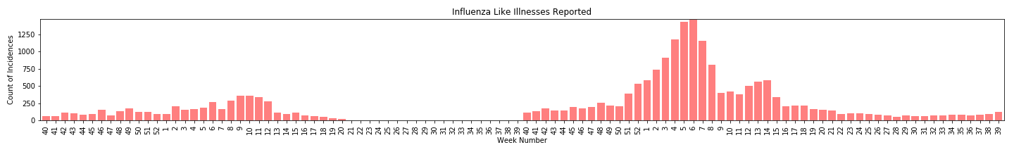
Data Analysis
Flu incidences for 2015-16 & 2016-17
Spikes in flu season activities are clear for 2015 vs 2016.
2016 season spike is significantly larger

Slide 6
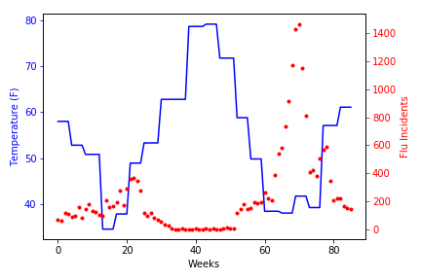
Data Analysis --Weather Patterns
Temperature vs Flu Incidents 2015-2017
Temperature appears to be roughly correlated
Temperature appears to lead incident count spikes
Temperature does not appear to explain Year over Year (YOY) differences though.
Follow up questions:
What is the lead time?
What drives the significant YoY difference?

Slide 7
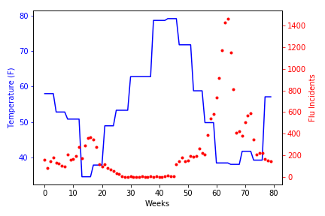
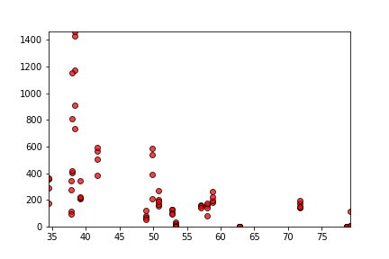
Data Analysis --Weather Lead Time
Studying the offset leadtime:
Roughly 6-weeks lead time in weather troughs vs flu spikes
Threshold of spike appears to begin roughly in the temperature range from low 30s through 50s

Slide 8
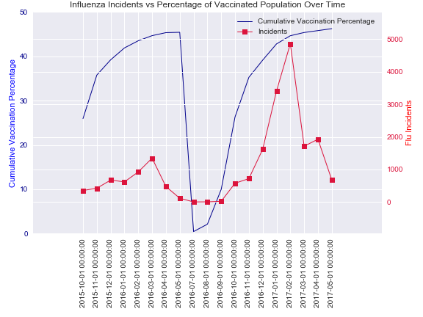
Data Analysis --Vaccinations
Vaccinations do not clearly impact the spike in flu incidents.
2016 vaccinations approximate 2015, which would imply 2016 flu incidents would be the same— but the data proves otherwise.

Slide 9
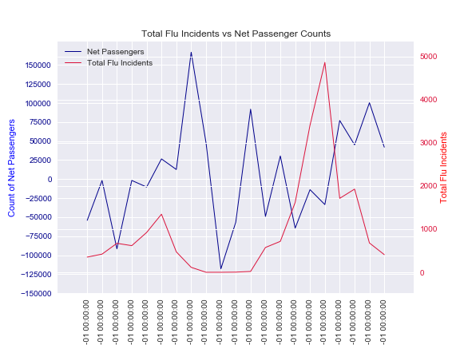
Air Travel vs Incidents
Air Travel appears to show low correlation, but does lag flu incidents.
Air travel does show correlation with weather patterns.

Slide 10
Discussion
Weather correlation-
Flu incidents are more likely during colder average temperatures.
Flu Incident Spikes-
The 2016 vaccine did not appear to be as effective as that of the 2015 vaccine.
Although air travel shows that spikes occurred while net passenger counts were closer to that of zero, it cannot fully explain why 2016 saw greater flu incidences than that of 2015.

Slide 11
Q & A Time
If we had time…
We would look into finding corollary factors that may have had effects on the 2015-2017 flu seasons.
We would explore more into vaccination effectiveness and why the vaccines for the 2016-17 flu season did not seem to be as effective.
Look into flu incubation periods and flu transmission patterns.
We would also explore data reporting and recording methods to verify accuracy.

